Slide 1
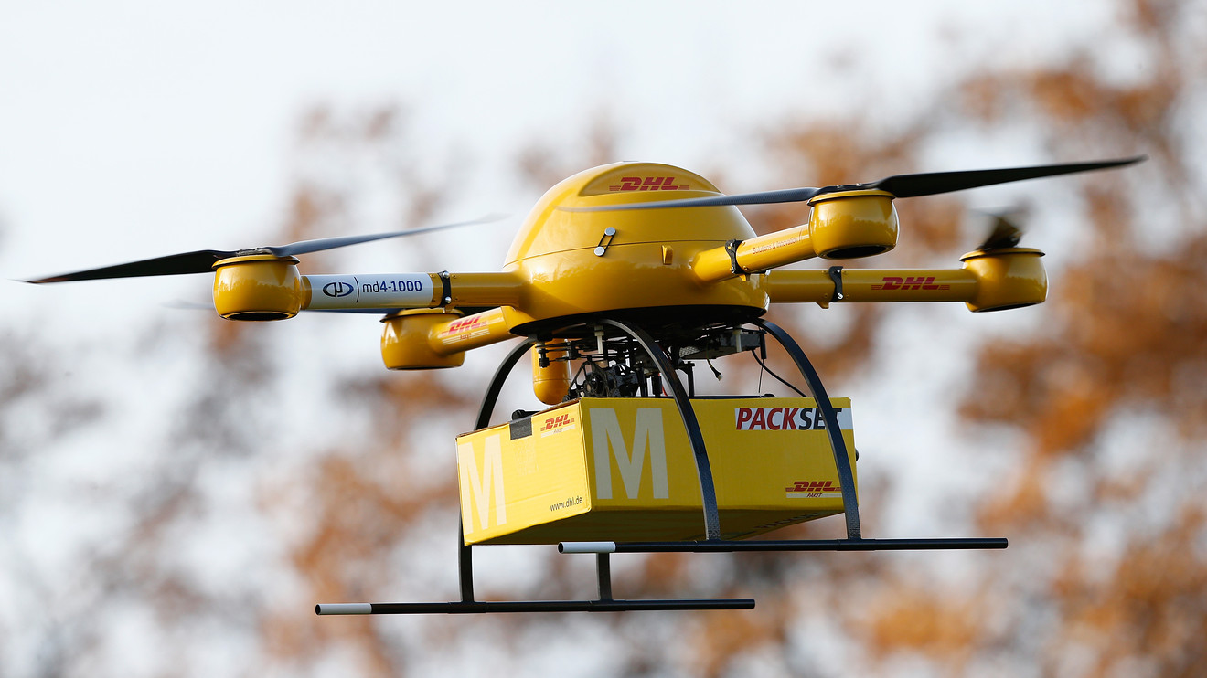
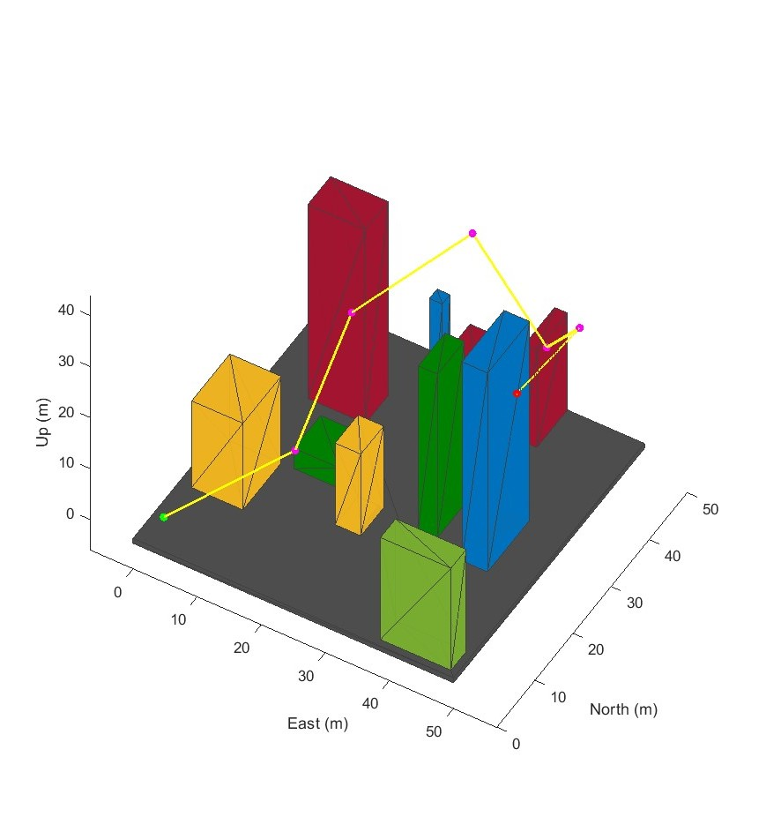
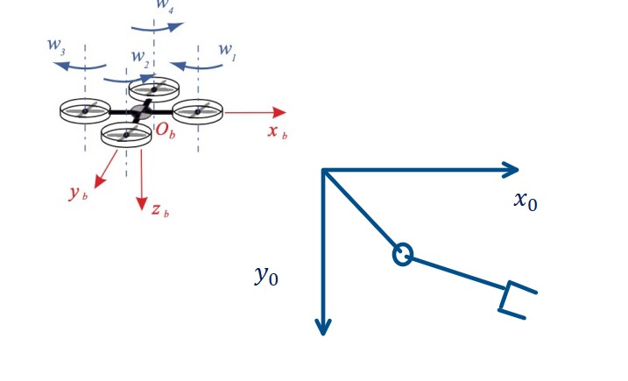
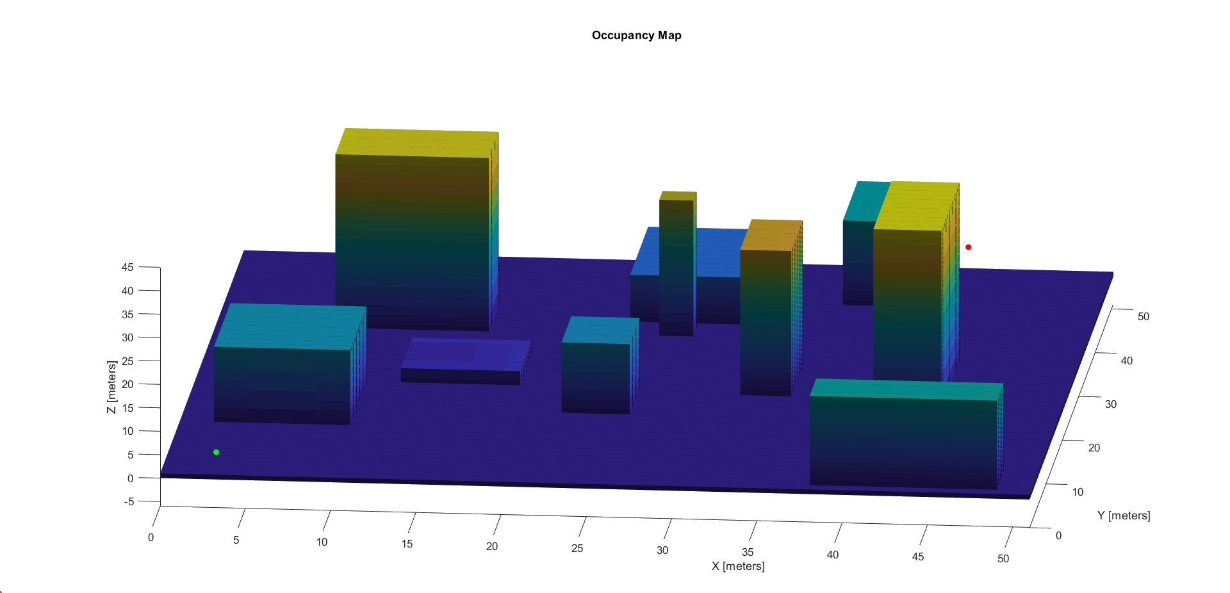
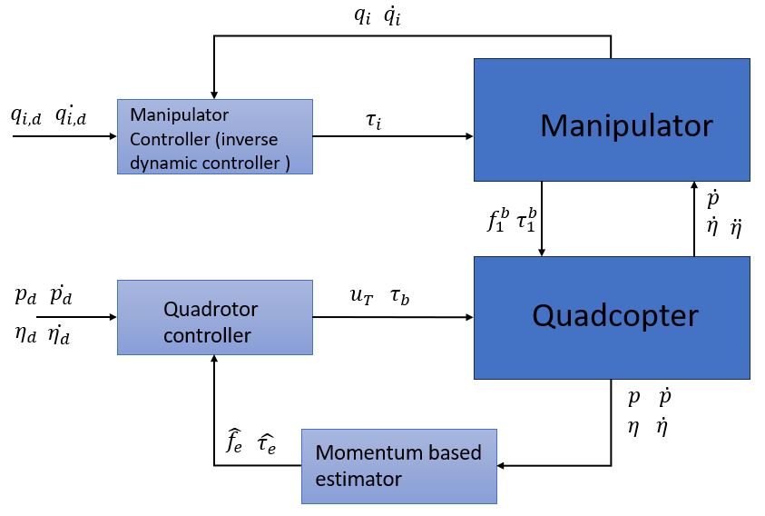
DIPARTIMENTO DI INGEGNERIA ELETTRICA E TECNOLOGIE DELL’INFORMAZIONE
SCUOLA POLITECNICA E DELLE SCIENZE DI BASE
FIELD AND SERVICE ROBOTICS TECHINCAL PROJECT
MODELLING, PLANNING AND CONTROL OF AN AERIAL MANIPULATOR
Giovanni Buiano Prof. P38000152 FABIO RUGGIERO Corrado Verde Academic Year 2022/2023 P38000139

Slide 2

SUMMARY
Modelling and task definition
Planning
Aerial Robot Controller
Hierarchical Controller
Passivity based controller
Geometric controller
Unmodelled effects
Aerial Manipulator
2/22

Slide 3
Modelling and Task definition
Task:
The Drone must reach the final delivery position and deploy the arm manipulator for an in-hand delivery.
The Drone must record some images for the commercial.
Quadcopter:
Mass= 2 kg
Inertia Matrix= diag([ 1.246 1.246 2*1.246])
Link length = 0.3 m
2 dof Manipulator:
Link1 mass= 0.049 kg
Link2 mass= 0.05 kg
Link1 length= 15 cm
Link2 length= 5 cm
Link1 Inertia= 0.0011 kg×m2
Link2 Inertia= 1.25e−4kg×m2
3/22

Slide 4
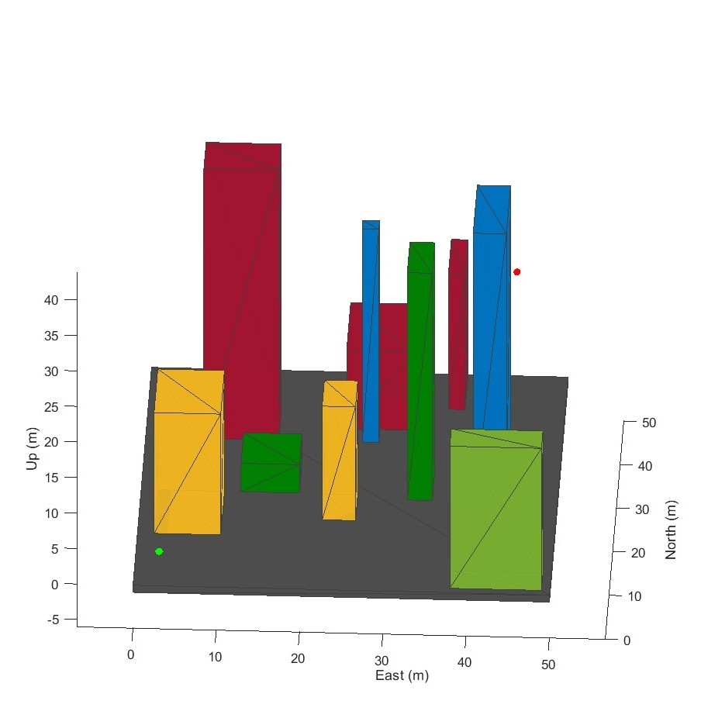
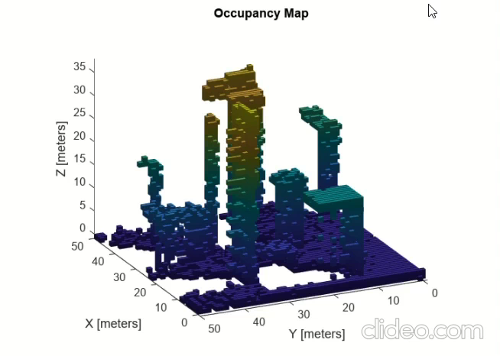
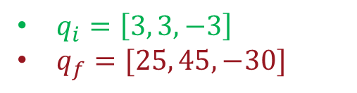
Planning
For our task, we consider a 3D enviroment with dimension 50x50 m, with variable heights. We suppose to obtain this type of enviroment from 3D satellite images
$q_{i}=\left[3, 3, −3\right]$
$q_{f}=[25, 45, −30]$
In order to implement a 3D motion plannning algorithm we need to retrieve from this 3D scene a 3D occupancy grid map, using LIDAR sccaner
4/22

Slide 5
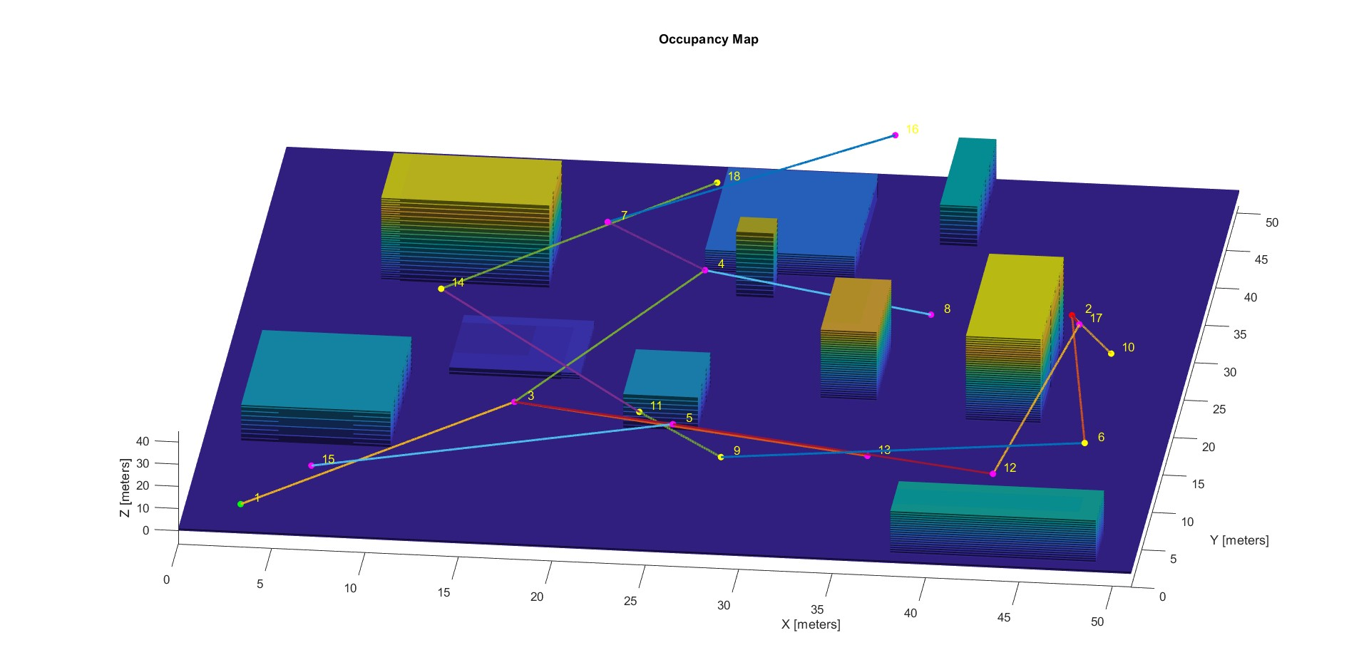
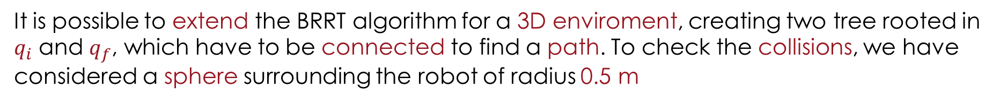
Planning: BRRT
It is possible to extend the BRRT algorithm for a 3D enviroment, creating two tree rooted in $q_{i}$ and $q_{f}$, which have to be connected to find a path. To check the collisions, we have considered a sphere surrounding the robot of radius 0.5 m
The algorithm is able to find a path with an avarage of 30- 40 iterations.
5/22

Slide 6
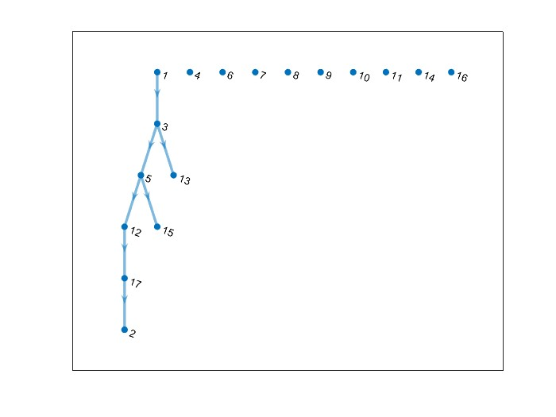
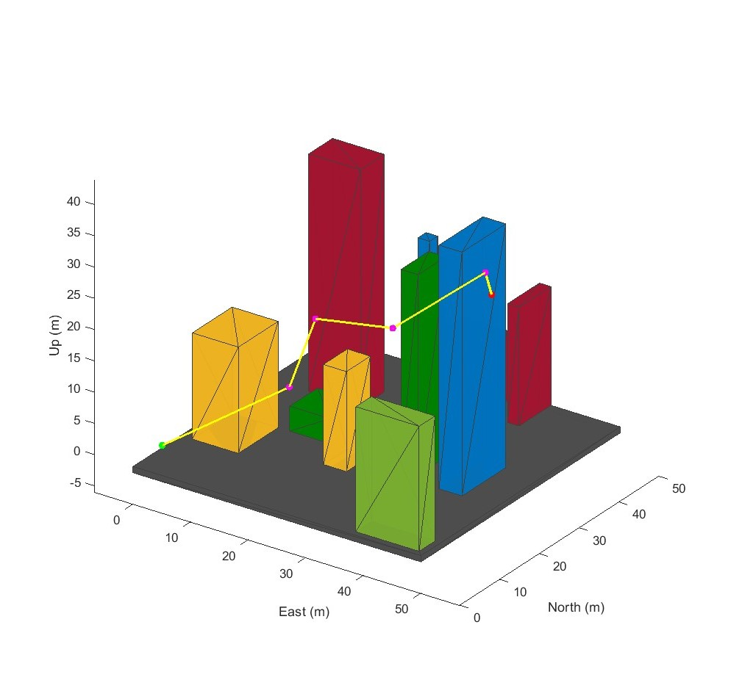
Planning: DFS
Using a Graph Search Algorithm like DFS it is possible to find an unique path connecting the starting configuration to the goal configuration. Knowing the connection among nodes, an adjacency matrix can be found, and the final output is the DFS tree with the sequence of nodes that are visited starting from the initial one, and where it is possible to retrieve the path.
DFS TREE
Path in the 3D scene
6/22

Slide 7
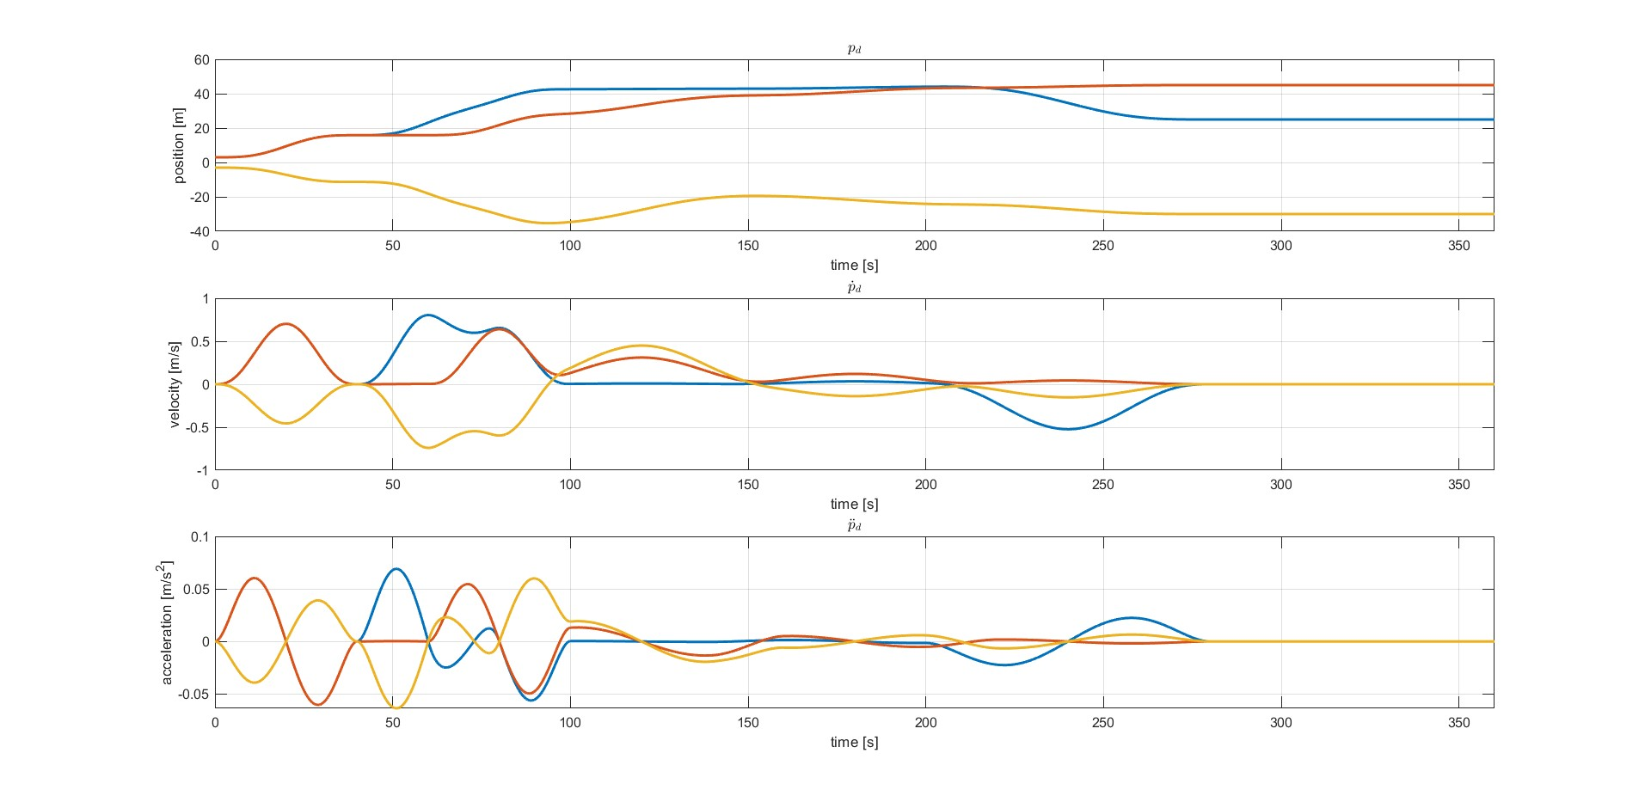
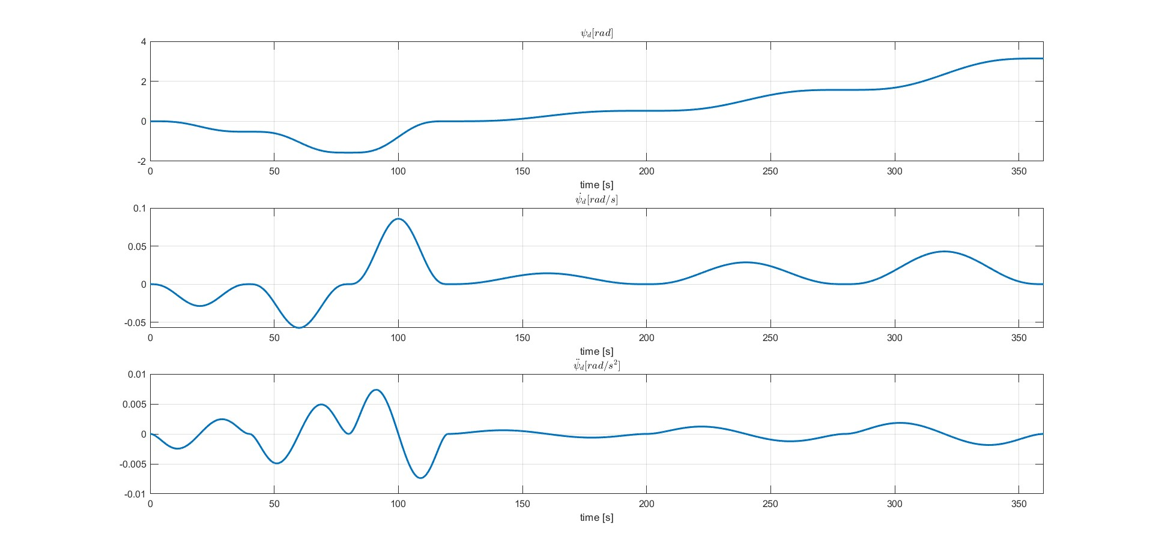
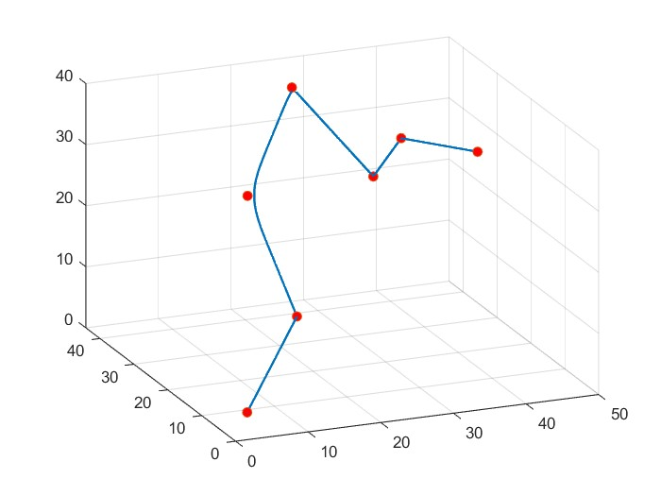


Planning: Defining the time law
For the task purpose, among the possible path we select the one seen in figure. Once we have defined the geometric path, we need to the define the time law necessary to build the references for our controllers. It has been choosen as seventh order polynomial to guarantee smootheness also in the acceleration and jerk. Via points have been inserted so the robot does not stop in the middle points of the trajectory
$$p_{d},{\dot{p}}_{d},{\ddot{p}}_{d}$$
Final Path
$$ψ_{d},{\dot{ψ}}_{d},{\ddot{ψ}}_{d}$$
Via Points
7/22

Slide 8
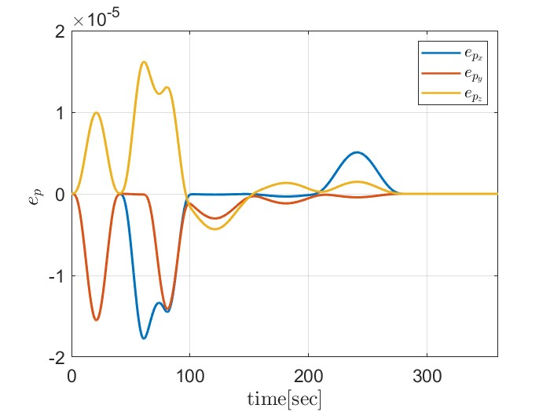
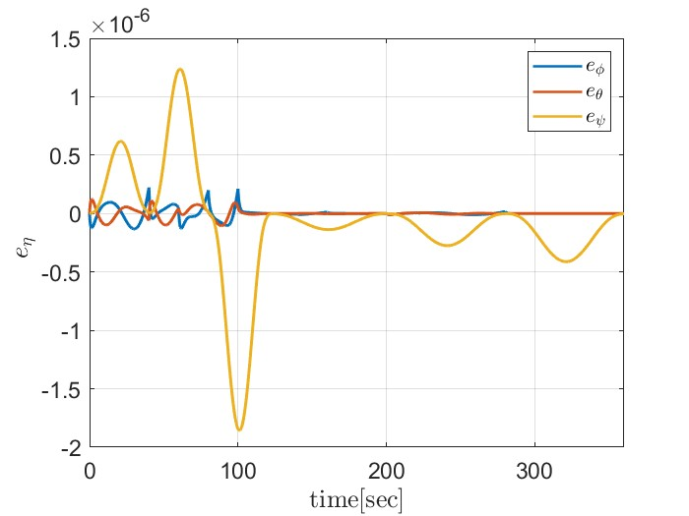
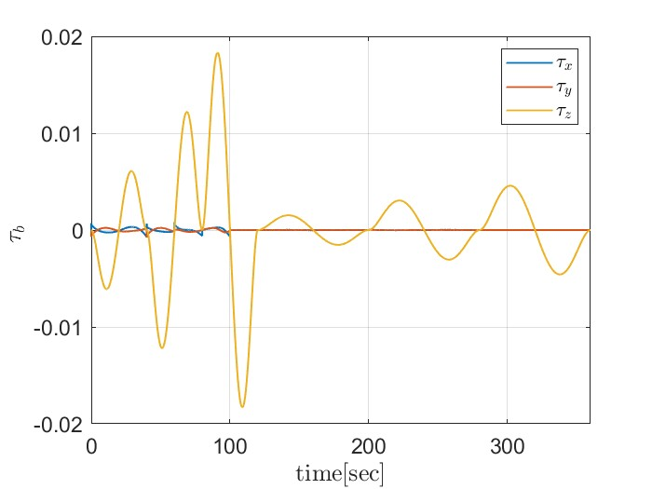
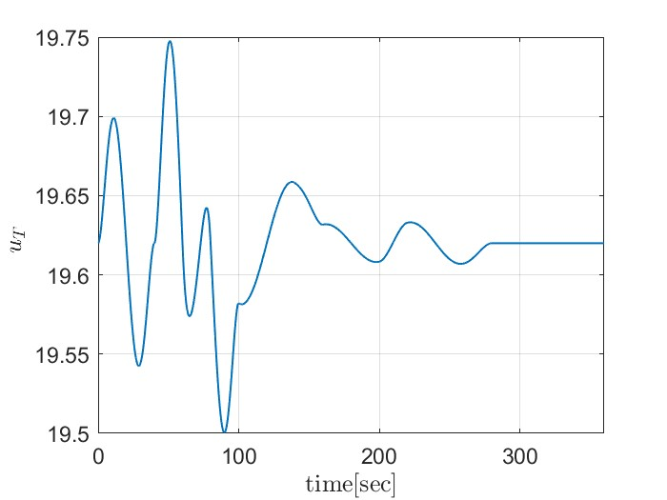
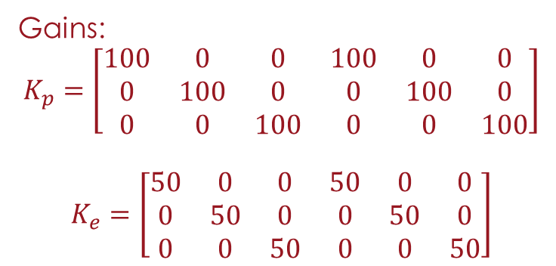
Hierarchical Controller
Based on the RPY dynamic model of the UAV, the controller is able to succesfully track the position and orientation references, with convergence to zero of the error and bounded control inputs.
Gains:
$$K_{p}=\left[\begin{matrix}100 & 0 & 0 & 100 & 0 & 0 \\ 0 & 100 & 0 & 0 & 100 & 0 \\ 0 & 0 & 100 & 0 & 0 & 100\end{matrix}\right]$$ $$K_{e}=\left[\begin{matrix}50 & 0 & 0 & 50 & 0 & 0 \\ 0 & 50 & 0 & 0 & 50 & 0 \\ 0 & 0 & 50 & 0 & 0 & 50\end{matrix}\right]$$
8/22

Slide 9
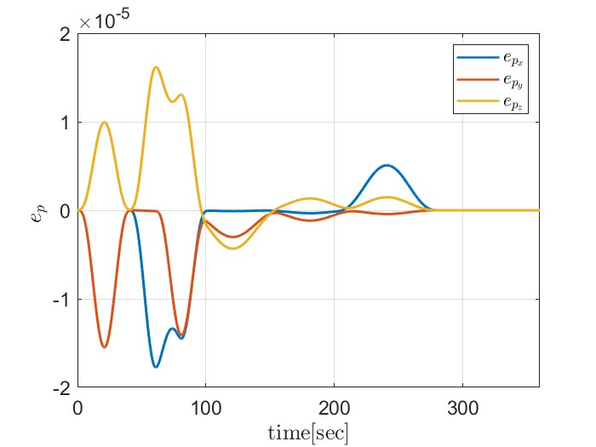
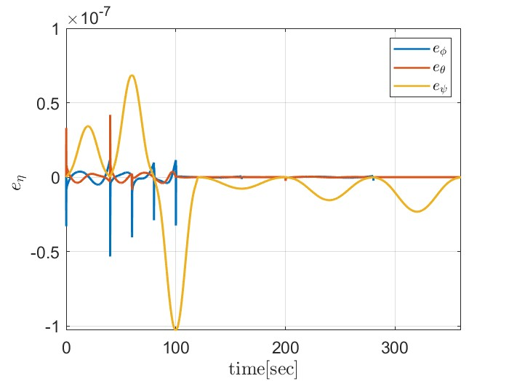

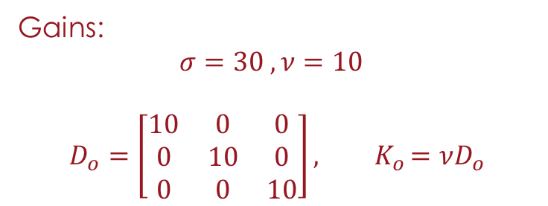
Passivity Based Controller
The contol scheme is identical for the linear part to the previous controller, but this controller does not require FBL for the angular part. The performance are very similar to the Hierarchical controller
Gains:
$$σ=30 ,ν=10$$ $$D_{o}=\left[\begin{matrix}10 & 0 & 0 \\ 0 & 10 & 0 \\ 0 & 0 & 10\end{matrix}\right]{, K}_{o}=νD_{o}$$
9/22

Slide 10
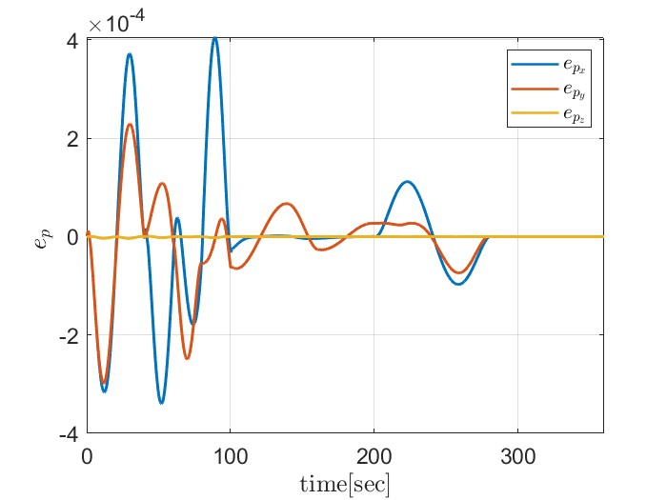
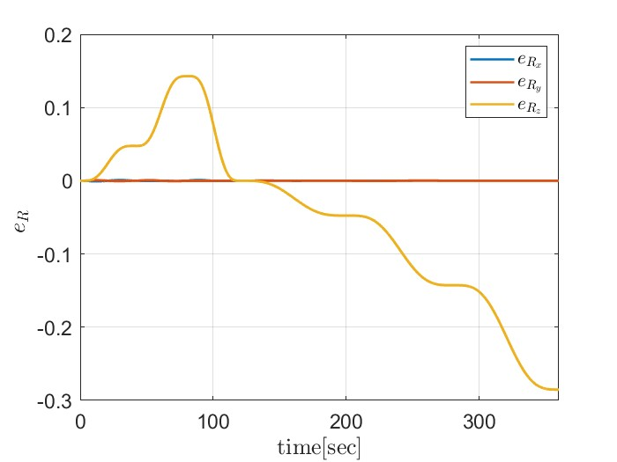

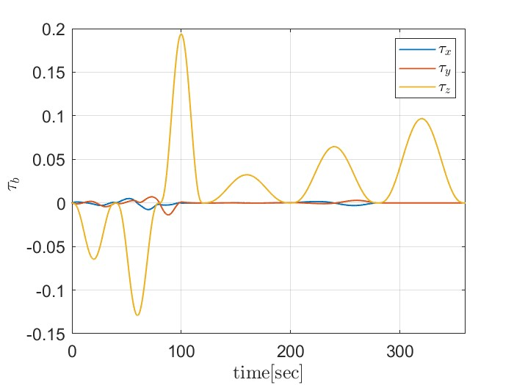
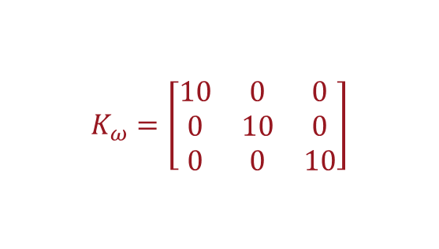
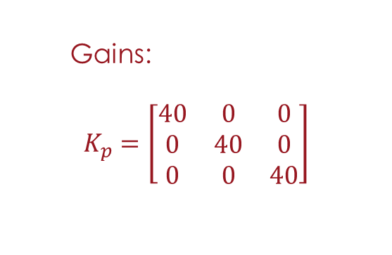
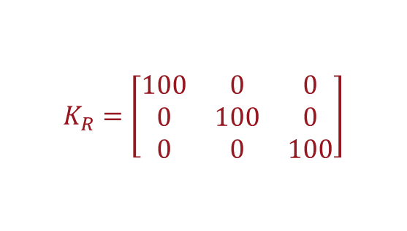

Geometric Controller
This control is different from the previous two because are defined on the coordinate-free model of the UAV, so it does not suffer from singularities of representation.
But how we can see the attitude error is bounded but does not go to zero.
Gains:
$$K_{p}=\left[\begin{matrix}40 & 0 & 0 \\ 0 & 40 & 0 \\ 0 & 0 & 40\end{matrix}\right]$$
$$K_{v}=\left[\begin{matrix}1 & 0 & 0 \\ 0 & 1 & 0 \\ 0 & 0 & 1\end{matrix}\right]$$
$$K_{R}=\left[\begin{matrix}100 & 0 & 0 \\ 0 & 100 & 0 \\ 0 & 0 & 100\end{matrix}\right]$$
$$K_{ω}=\left[\begin{matrix}10 & 0 & 0 \\ 0 & 10 & 0 \\ 0 & 0 & 10\end{matrix}\right]$$
10/22

Slide 11
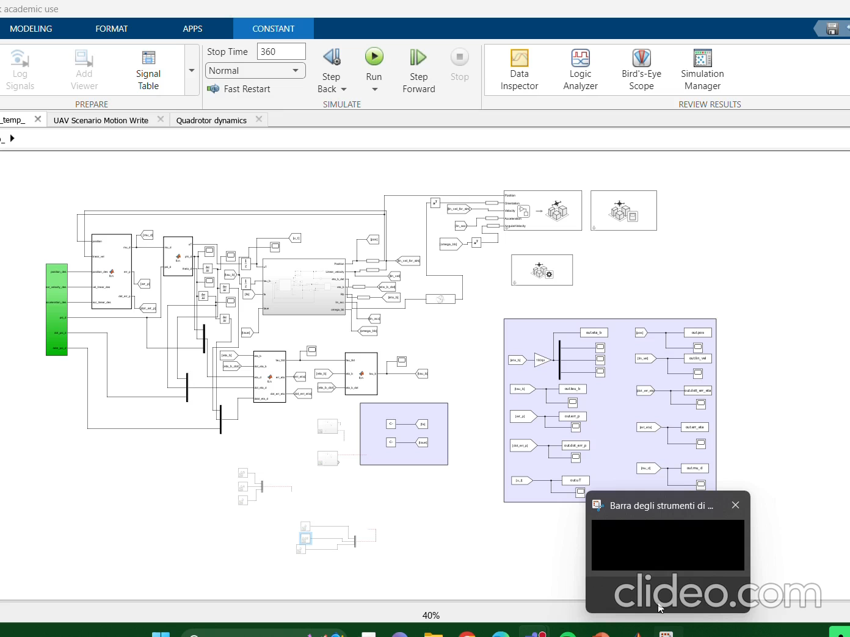
Simulation in the 3D enviroment
11/22

Slide 12
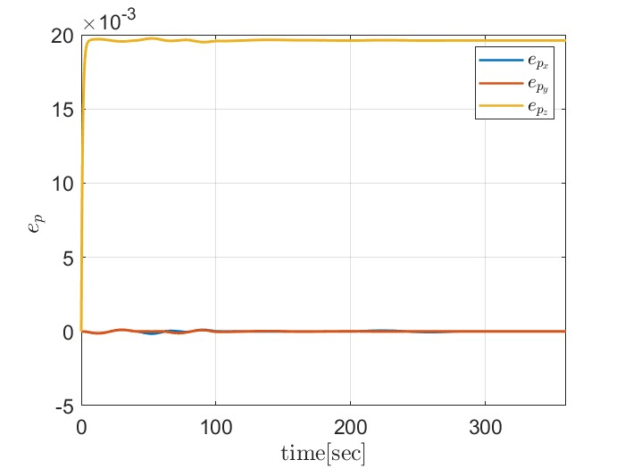
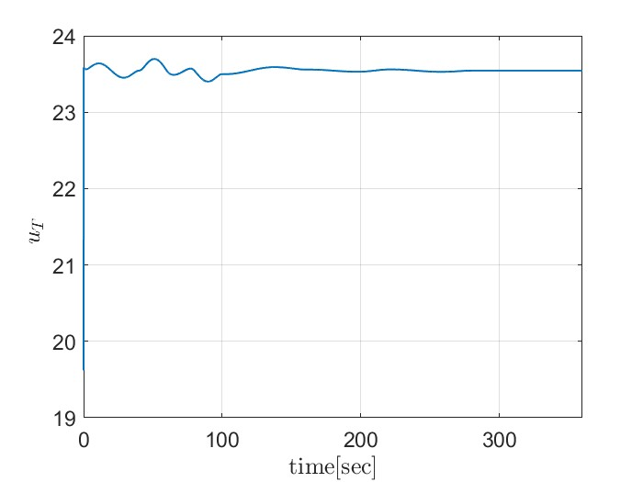
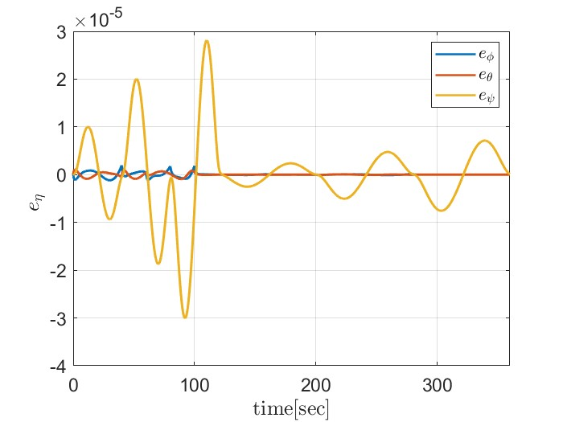
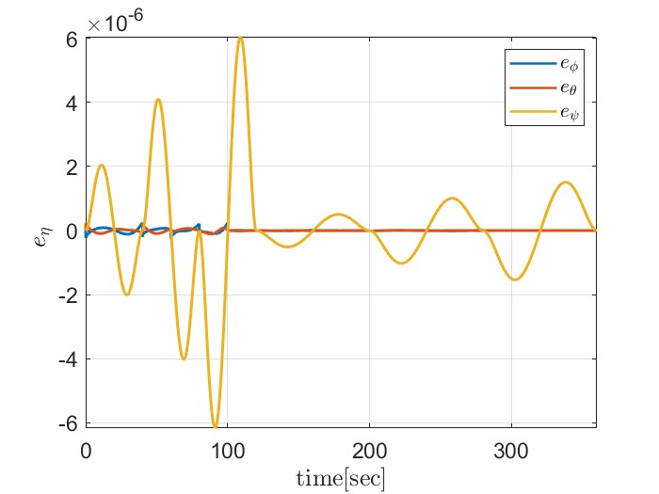




Parametric Uncertanties
We consider the following uncertanties:
20% on the value of the mass
20% on the value of inertia matrix
As expected, the variation on the value of the mass brings to a constant error in position, with an increase of the total thrust in order to compensate for it. Regarding the angular part, we can see that error is smaller in the passivity based becouse it does not rely on FBL
$e_{p}$ Hierarchical
$u_{T}$ Hierarchical
$e_{η}$ Hierarchical
$e_{η}$ Passivity Based
12/22

Slide 13
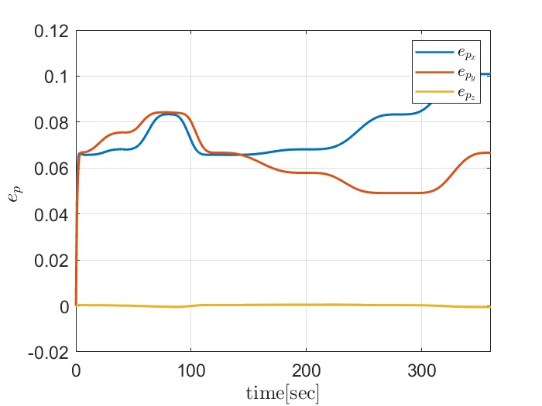
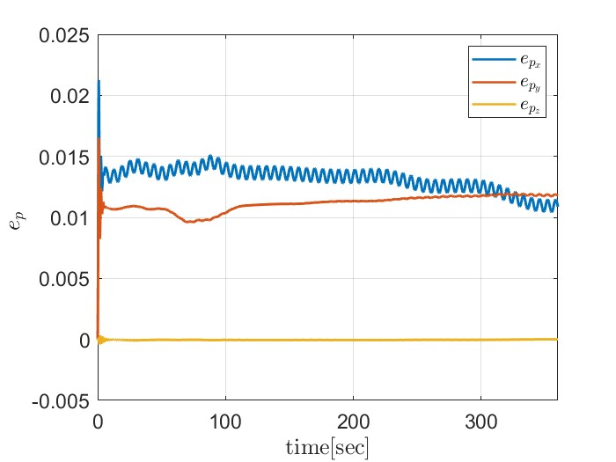
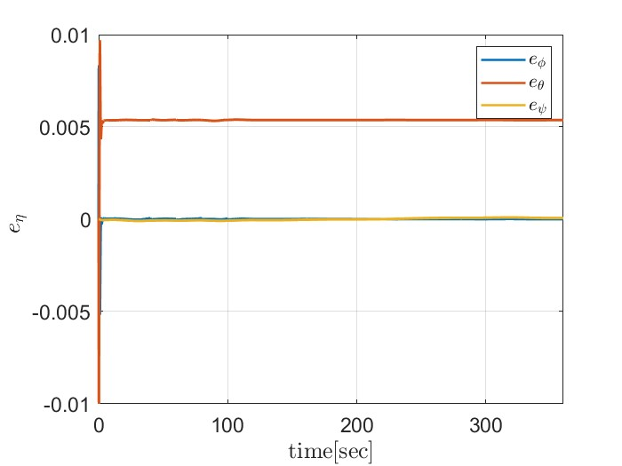
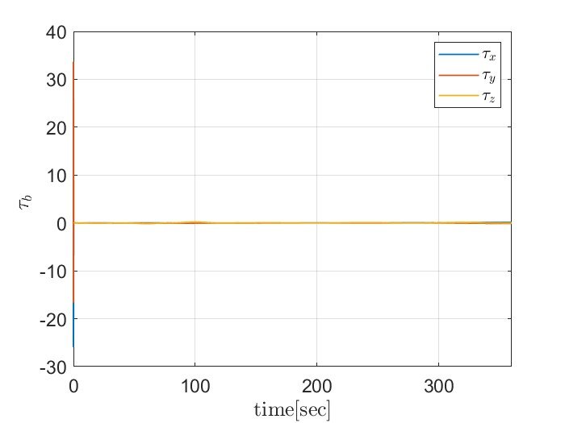



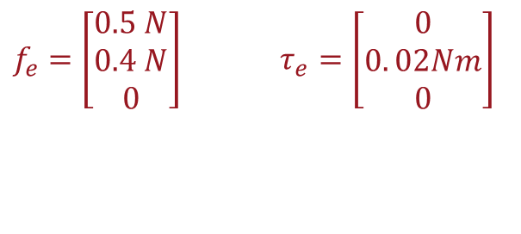

Constant external disturbances
$f_{e}=\left[\begin{matrix}0.5 N \\ 0.4 N \\ 0\end{matrix}\right]$ $τ_{e}=\left[\begin{matrix}0 \\ 0. 02Nm \\ 0\end{matrix}\right]$
Applying constant disturbances, brings to a constant error in position and orientation for the Hierarchical, while for the geomteric controller other than that we can observe an oscillatory behaviour. The control input in the Geometrical controller is too high in the initial value
$e_{p}$ Hierarchical
$e_{p}$ Geometrical
$e_{η}$ Hierarchical
$τ_{b}$Geometrical
13/22

Slide 14
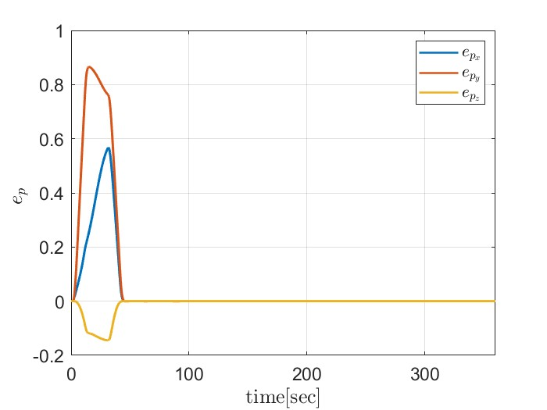
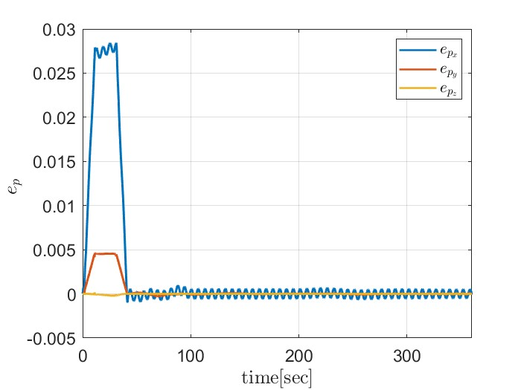
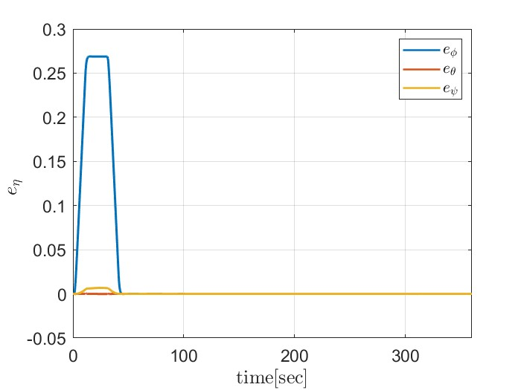
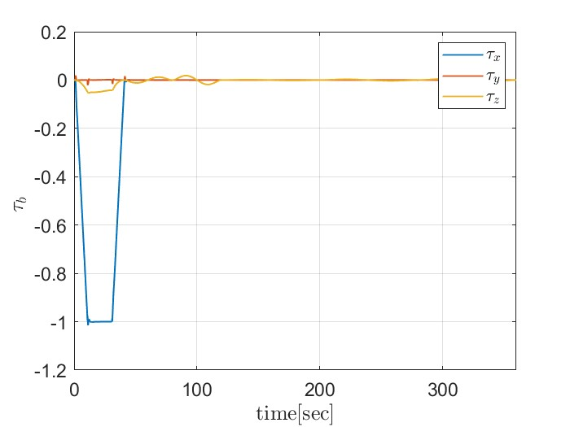



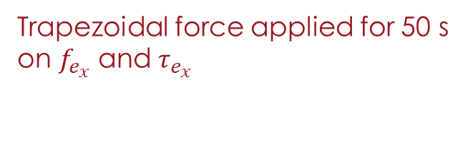

Trapezoidal external disturbances
Trapezoidal force applied for 50 s on $f_{e_{x}}$ and $τ_{e_{x}}$
The disturbance bring to a high error in position for the Hierarchical Controller, while the Geometrical still has the same oscillatory behaviour
$e_{p}$ Hierarchical
$e_{p}$ Geometrical
$e_{η}$ Hierarchical
$τ_{b}$Hierarchical
14/22

Slide 15
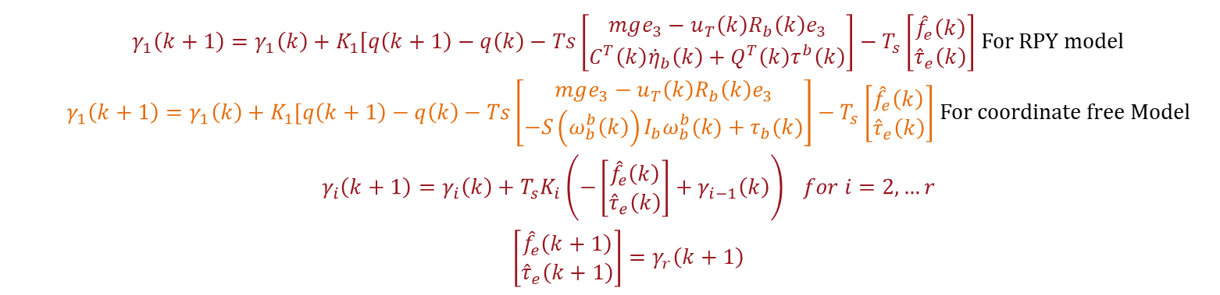
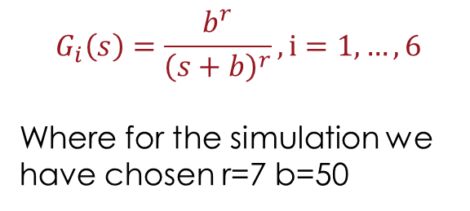
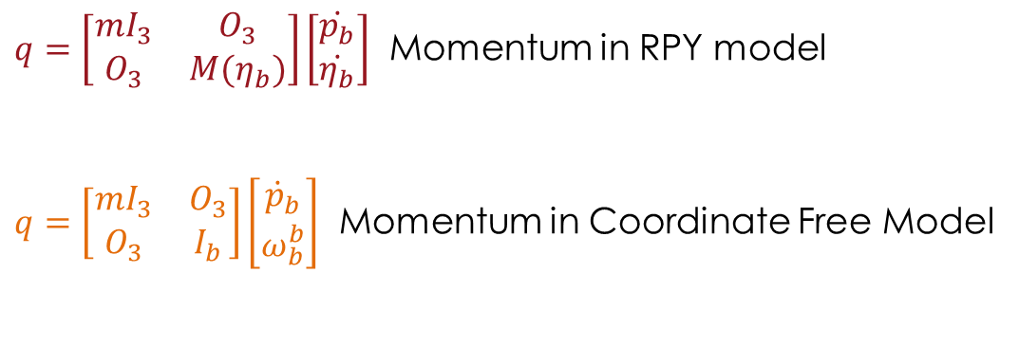
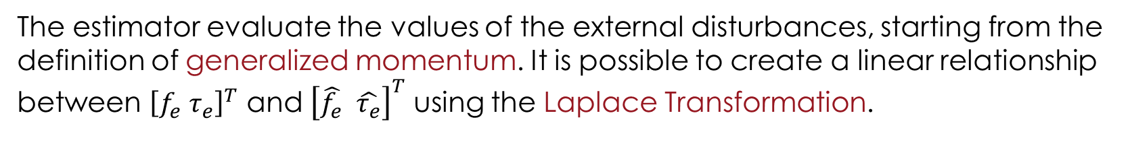
Momentum Based Estimator
The estimator evaluate the values of the external disturbances, starting from the definition of generalized momentum. It is possible to create a linear relationship between ${\left[f_{e} τ_{e}\right]}^{T}$ and ${\left[\hat{f_{e}} \hat{τ_{e}}\right]}^{T}$ using the Laplace Transformation.
$$G_{i}\left(s\right)=\frac{b^{r}}{{\left(s+b\right)}^{r}}, i=1,…,6$$
Where for the simulation we have chosen r=7 b=50
$q=\left[\begin{matrix}mI_{3} & O_{3} \\ O_{3} & M(η_{b})\end{matrix}\right]\left[\begin{matrix}\dot{p_{b}} \\ \dot{η_{b}}\end{matrix}\right]$ Momentum in RPY model
$q=\left[\begin{matrix}mI_{3} & O_{3} \\ O_{3} & I_{b}\end{matrix}\right]\left[\begin{matrix}{\dot{p}}_{b} \\ ω_{b}^{b}\end{matrix}\right]$ Momentum in Coordinate Free Model
$γ_{1}\left(k+1\right)=γ_{1}\left(k\right)+K_{1}[q\left(k+1\right)−q\left(k\right)−Ts\left[\begin{matrix}mge_{3}−u_{T}\left(k\right)R_{b}\left(k\right)e_{3} \\ C^{T}\left(k\right){\dot{η}}_{b}\left(k\right)+Q^{T}\left(k\right)τ^{b}\left(k\right)\end{matrix}\right]−T_{s}\left[\begin{matrix}{\hat{f}}_{e}\left(k\right) \\ {\hat{τ}}_{e}\left(k\right)\end{matrix}\right]$ For RPY model $γ_{1}\left(k+1\right)=γ_{1}\left(k\right)+K_{1}[q\left(k+1\right)−q\left(k\right)−Ts\left[\begin{matrix}mge_{3}−u_{T}\left(k\right)R_{b}\left(k\right)e_{3} \\ −S\left(ω_{b}^{b}\left(k\right)\right)I_{b}ω_{b}^{b}(k)+τ_{b}(k)\end{matrix}\right]−T_{s}\left[\begin{matrix}{\hat{f}}_{e}\left(k\right) \\ {\hat{τ}}_{e}\left(k\right)\end{matrix}\right]$ For coordinate free Model $$γ_{i}\left(k+1\right)=γ_{i}\left(k\right)+T_{s}K_{i}\left(−\left[\begin{matrix}{\hat{f}}_{e}\left(k\right) \\ {\hat{τ}}_{e}\left(k\right)\end{matrix}\right]+γ_{i−1}\left(k\right)\right) for i=2,…r$$ $\left[\begin{matrix}{\hat{f}}_{e}\left(k+1\right) \\ {\hat{τ}}_{e}\left(k+1\right)\end{matrix}\right]=γ_{r}\left(k+1\right)$
15/22

Slide 16
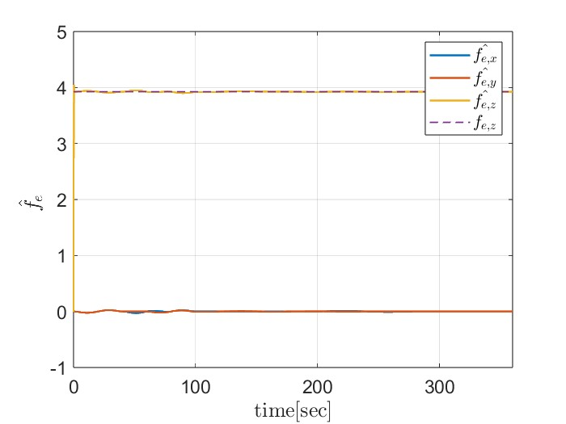
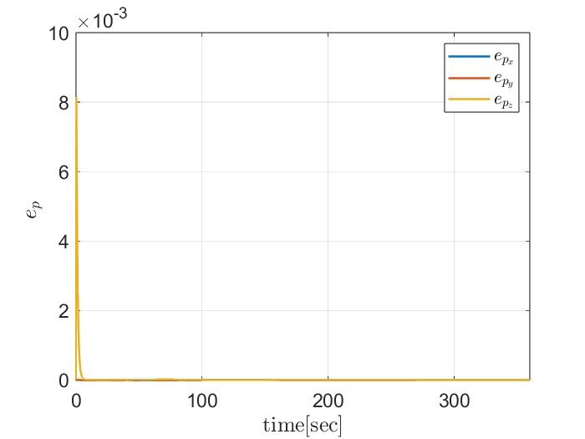








Comparison among controllers using estimator: Paramteric Uncertanties
The extra load is seen as external force acting on the z axes and it is perfectly compensated
Force estimation Hierarchical
$e_{p}$ Hierarchical
$u_{T}$Hierarchical
Force estimation Geometrical
$e_{p}$ Geometrical
$u_{T}$Geometrical
16/22

Slide 17








Comparison among controllers using estimator: Constant Disturbances
Hierarchical
Geometrical
17/22

Slide 18








Comparison among controllers using estimator
Comparison among controllers using estimator: Trapezoidal Disturbances
Hierarchical
Geometrical
18/22

Slide 19
Aerial Manipulator Controller
The Newton-Euler recursive algorithm allows considering the boundary conditions between the manipulator and its base. In classical manipulators, the base is fixed. Hence, the forces and moments computed in the backward iteration are canceled by the reactions on the base. For UAMs, the base is the flying vehicle.
For the simulation, some assumptions has been made:
the first link of the manipulator has been attached precisely in the center of mass of the drone
the velocities of the drone are not too fast
19/22

Slide 20






Aerial Manipulator Controller
Newton-Euler recursive algorithm
$$f_{1}^{1},μ_{1}^{1}$$
$$R_{1}^{0}$$
$$f_{1}^{0},μ_{1}^{0}$$
$R_{1}^{0}$ can be found from the direct kinematics of the arm
$R_{0}^{b}$is only defined from a rotation of $−\frac{π}{2}$around the x-axis
$$R_{0}^{b}$$
$$f_{1}^{b}=R_{0}^{b}R_{1}^{0}f_{1}^{1}$$
$$μ_{1}^{b}=R_{0}^{b}R_{1}^{0}μ_{1}^{1}$$
20/22

Slide 21






Aerial Manipulator Controller (simulation)
In practice our manipulator starts from a position of rest so the external perturbations on the drone are an external force given by the weight force terms of the manipulator plus the mass. The manipulator starts to move when the drone is stopped around 305 s, and after the trajectory, the arm deploy the added mass.
Disturbances Estimation
21/22

Slide 22
Conclusions
Different aspect of the aerial robotics field have been explored, from the trajectory planning to the implementation of an aerial manipulator. All the three controller succesfully meet the task requirement and with the introduction of a momentum based estimator a reduction of the error brought by external disturbances and parametric uncertanties has been obtained. Regarding the Aerial Manipulation, many other aspect could be explored, such as more complex interaction with the environment, which requires an additional focus to model in a proper way such type of tasks.
Thanks for the attention
22/22

